Slide 1

Competitive Programming From Problem 2 Solution in O(1)
P
T
H
I
N
K
F
A
S
T
S
Passing Arguments
Mostafa Saad Ibrahim
PhD Student @ Simon Fraser University

Slide 2
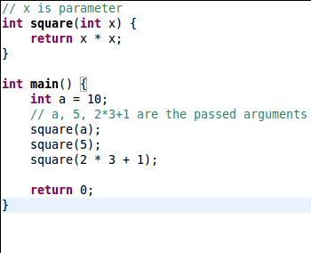
Argument vs Parameter

Slide 3
Passing Arguments?!
So far we either read from user or hard code values in the program
We can also pass to the program arguments, or CLI arguments, to start program based on them
Think in factorial application that takes integer as initial argument
Or program takes file path to do some initializations

Slide 4
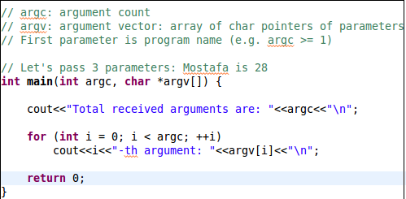
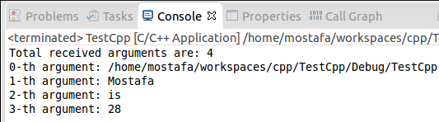
C++ argc and argv

Slide 5
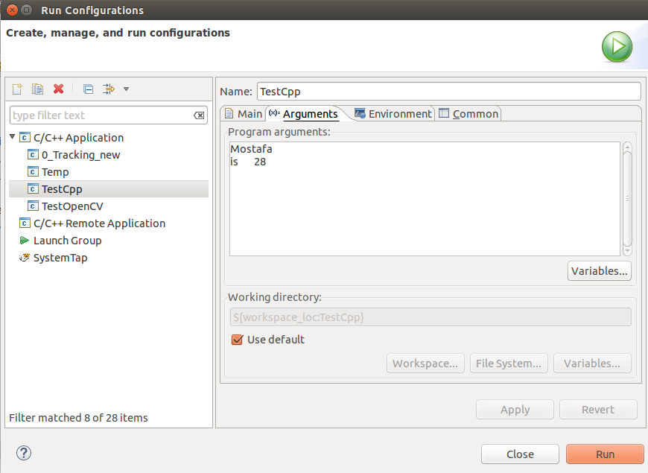
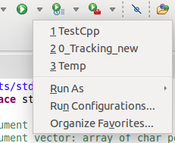
Passing arguments from Eclipse

Slide 6
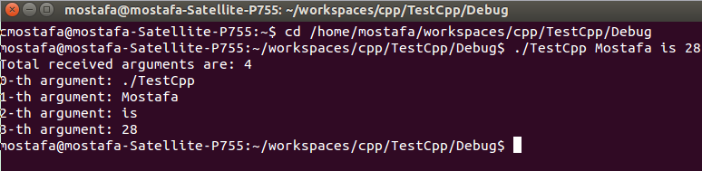
Run from command line

Slide 7
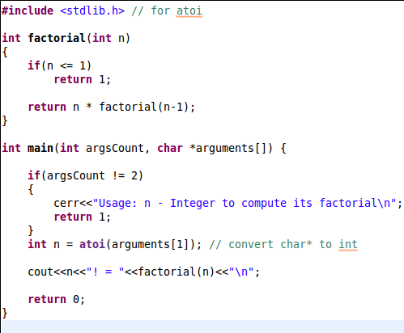
Factorial

Slide 8
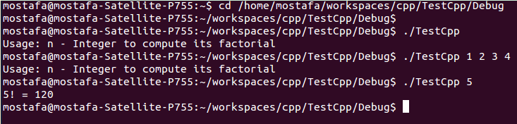
Factorial

Slide 9
تم بحمد الله
علمكم الله ما ينفعكم
ونفعكم بما تعلمتم
وزادكم علماً

